Slide 1
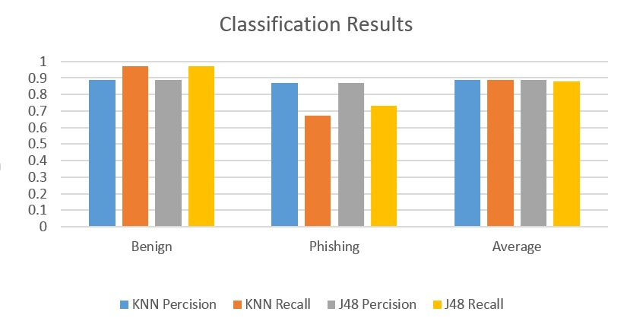
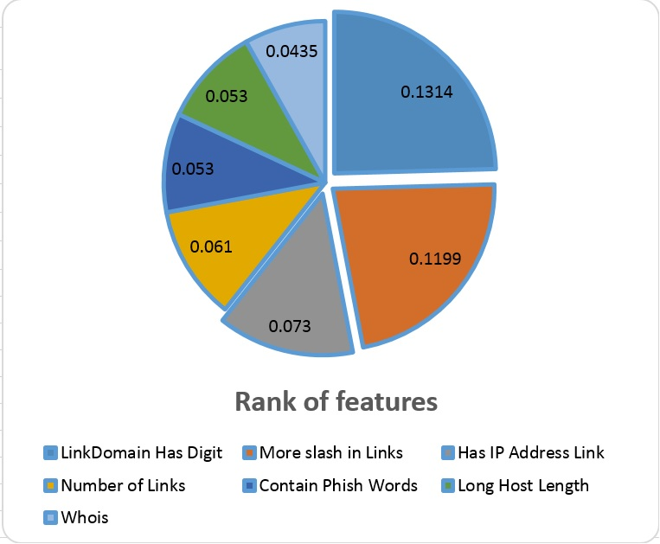
A New Phishing E-Mail Detection Approach
Kenneth F. Mbah, Ali A. Ghorbani
Information Security Center of Excellence (ISCX), UNB
Abstract
According to APWG reports of October 2014 through September 2015, the number of unique Phishing e-mail reports they received from consumers has tremendously increased from 68270 to 106421 phishing e-mails . This significant increase in phishing e-mails reported is a proof that the question of privacy is still without any efficient solution. Hence, the contribution of researchers is needed to accurately detect phishing to guarantee safety of users data. Though a myriad of efforts have been made in literature on detecting phishing e-mails, none of them have paid attention on some variant of phishing e-mail such as advertisement e-mails and e-mails related to pornography. In this work, we focus detection of all types of deceptive phishing e-mail attacks and their variants such as ad and porn e-mails. We propose a novel framework to accurately classify e-mails as phishing or legitimate by defining a set of classification rules based on high quality features. Our system yields about 89% accuracy.
Phishing attacks:
Experiment
Deceptive Phishing attacks
Malware-based Phishing attacks
Key logger and screen logger phishing attacks
Session hijacking attacks
Web Trojans attacks
Hosts files poisoning attacks
7) System reconfiguration attacks
8) Data theft attacks
9) DNS-Based Phishing attacks
10) Content-injection Phishing attacks
11) Man-in-the middle Phishing attacks
12) Search engine Phishing attacks
Dataset :
We are using a publicly available Dataset of 9308 e-mails to test our framework in which 6951 e-mails are labeled as legitimate and 2357 are phishing e-mails. The legitimate e-mails are from both the 2002 and 2003 ham collections, easy and hard, and the phishing ones are from the publicly available phishing corpus.
Features
FEATURES | FEATURES
Redirecting Signs | Number of dash
IP address in link | Domain Length
Misleading digits Characters | Image src
Whois | Out Bound Flow
@ in link | Number of dash and dots in sender’s address
Number Of Dots in link | Contain Phish words
More Slash In Link | Contain Porn Words
No. of Top level Domain | Number of broken Links
Digits in link | Number of links
Conclusion & Future Direction
The system we proposed based on the above selected features helps to accurately detect phishing deceptive e-mails. In the case of live detection, once an e-mail is alerted as phishing a reason is being attached to the system’s output and any decision to delete the e-mail is left to the user. Our nearest objective is to add the number of features mostly extracted from the sender’s ID in order to greatly increase the detection accuracy.

